Slide 1
Project 3: Design Space Exploration of Model Serving
CSCE 790
Bharart Harrison Jianhan

Slide 2
Introduction
Model Serving - simplify deployment of ML systems
An alternative to a flask app
Allow for more effective scaling and managing
Increases the elasticity of the system
Notes:
https://medium.com/@vikati/the-rise-of-the-model-servers-9395522b6c58

Slide 3
Goal
Decrease latency of Tensorflow model serving by finding optimal configuration parameters

Slide 4
Importance
Most models will be deployed to cloud service providers
Providers may charge on the basis of service usage
Minimize serving cost
Increase user satisfaction

Slide 5
Previous Work
S. Sidhanta, W. Golab and S. Mukhopadhyay, "OptEx: A Deadline-Aware Cost Optimization Model for Spark," 2016 16th IEEE/ACM International Symposium on Cluster, Cloud and Grid Computing (CCGrid)(CCGRID), Cartagena, Colombia, 2016, pp. 193-202.
Estimate an optimal cluster configuration given a deadline
Interior Point Algorithm
Liu, Hung-Yi and Diakonikolas, Ilias and Petracca, Michele and P. Carloni, Luca, “Supervised design space exploration by compositional approximation of Pareto sets” 2011 Proceedings - Design Automation Conference, Columbia, 2011, pp. 399-404
Iteratively refine approximation with promising parameter settings
Dimension reduction favor potentially hard-to-predict parameter settings if they are not selected as training examples
Notes:
Interior Point Algorithm solve linear and nonlinear convex optimization problems
With tools for designing hardware components, find approximate a component Pareto set by iteratively refining the approximation with promising knob settings, guided by synthesis-result estimation with machine-learning models

Slide 6


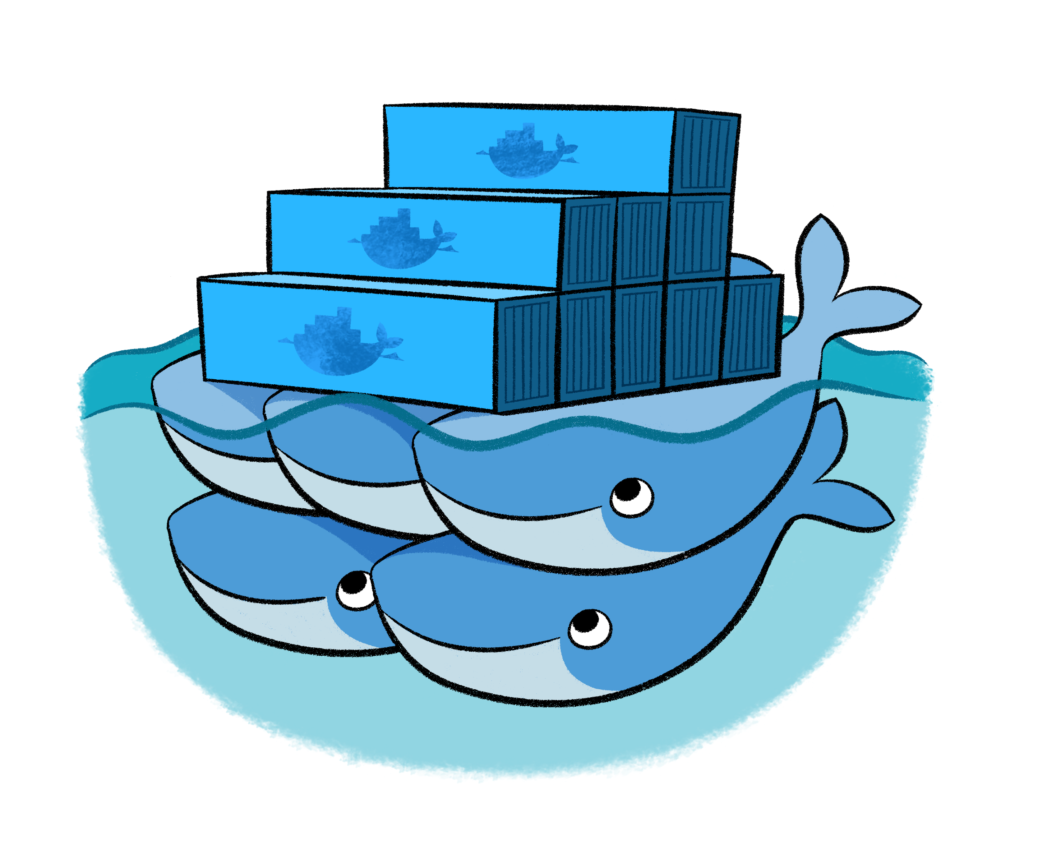
Tools
Python
Tensorflow Model Serving
Docker + Docker Swarm

Slide 7
Terminology
saved_model.Builder - A python module to create a snapshot of the model
Docker Image - An executable package containing the saved model, run-time libraries, and environmental variables
Docker Container - A runtime instance of an image that runs natively on the OS
Docker Service - Define, run and scale a function of an application
Increases resilience
Docker-compose - A configuration file that defines how docker service will behave in deployment

Slide 8
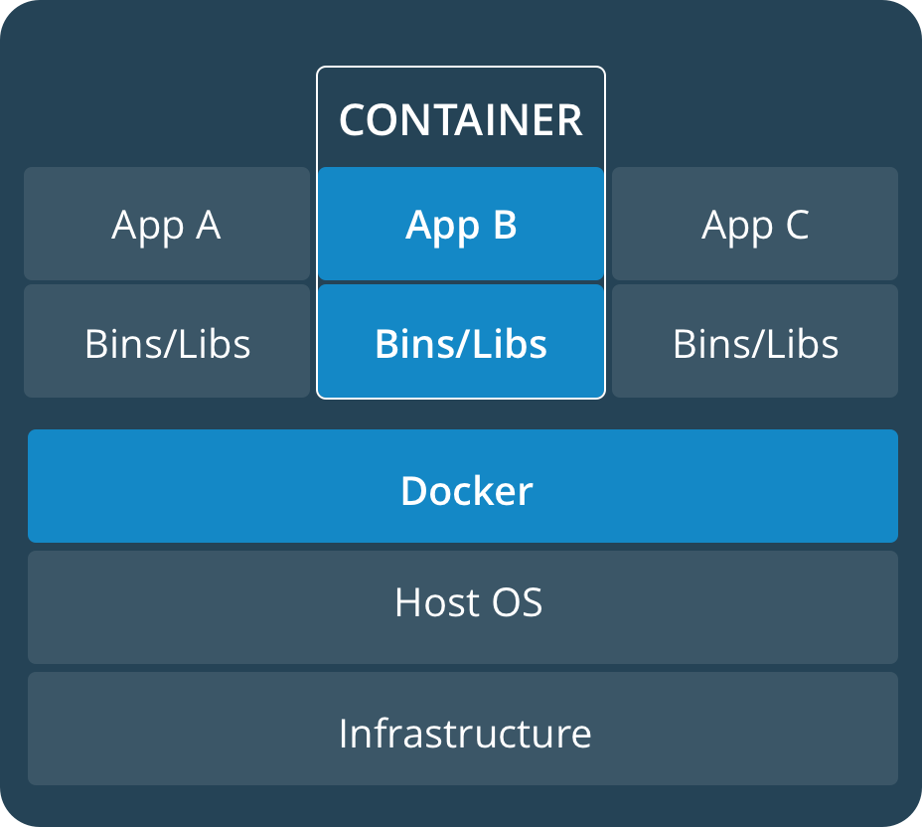
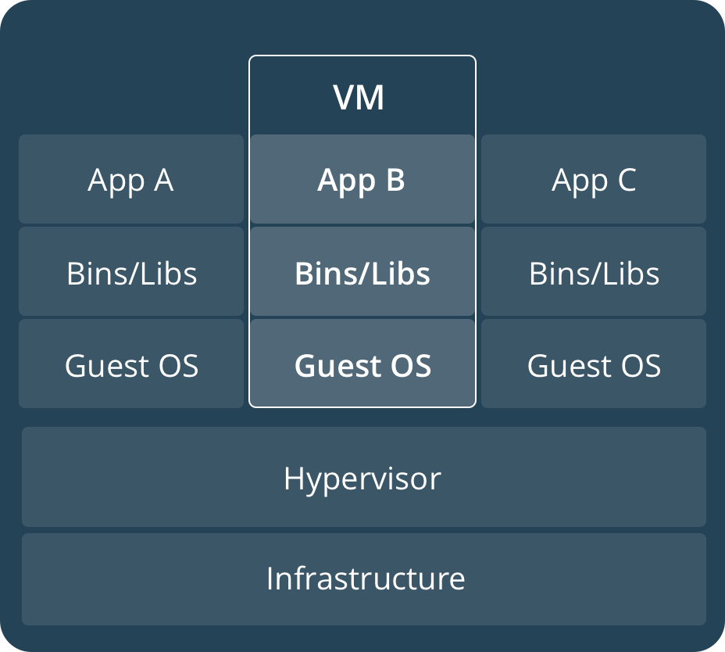
Docker container vs Virtual Machine

Slide 9
Deep Neural Networks
OPENMT-tf, Neural Machine Translation - GPU: Text workload
DeepSpeech V0.1.0, Speech-To-Text - CPU: Audio workload

Slide 10
Experiment Design
Latency + Configuration
Docker Swarm
Container 1
Docker Service
Input Data
Load Generator
Image
Load
Balance
Container 2
Client Script
Image
Container 3
docker-compose
Image

Slide 11
Optimizing Configurations
Sample Random Selection of Configurations and record the the latency
Feed these results to Bayesian Optimizer and run the optimization

Slide 12
Experiment Setting
GAN: A pre-built model obtained from a Github repo
Testset: 3413 32X32 png images
Use docker in one machine to simulate server center
Testing Machine: 8 CPU, 2 threads per core, 16G Memory
Client script runs in the same machine.

Slide 13
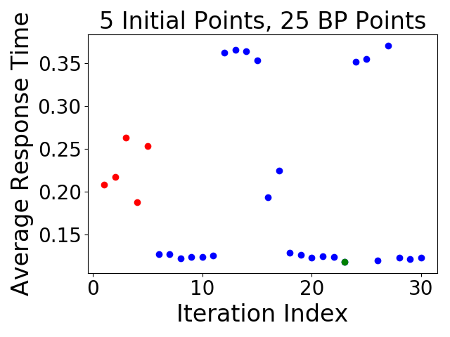
Number of Concurrent: 20
num_containers: 1, max_cpu: 0.85, max_mem: 557

Slide 14
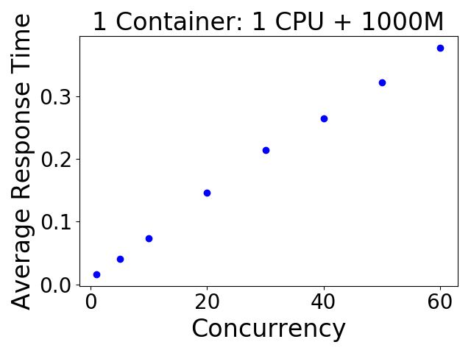
Impact of the number of concurrent
Experimental Setting: Test with 7 numbers of concurrent:
1, 5, 10, 15, 20, 30, 40, 50, 60
Observation: the average response time is linear to the number of concurrent.

Slide 15
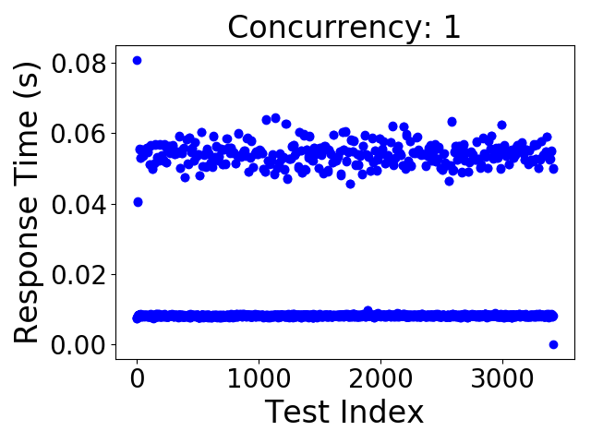
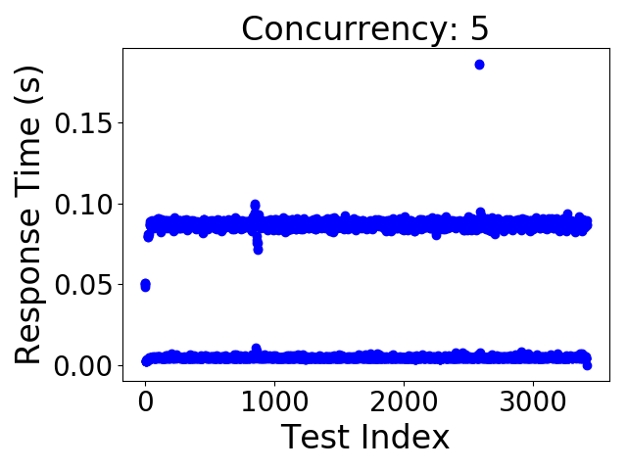
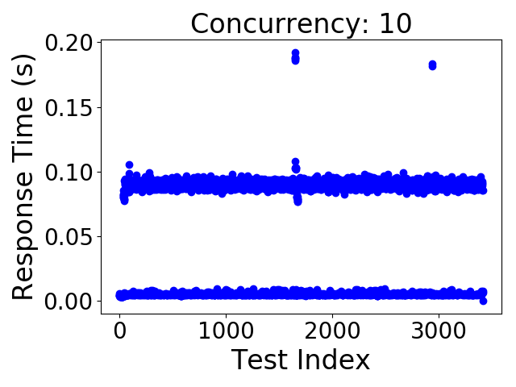
Interesting Observation 1
Two clusters

Slide 16
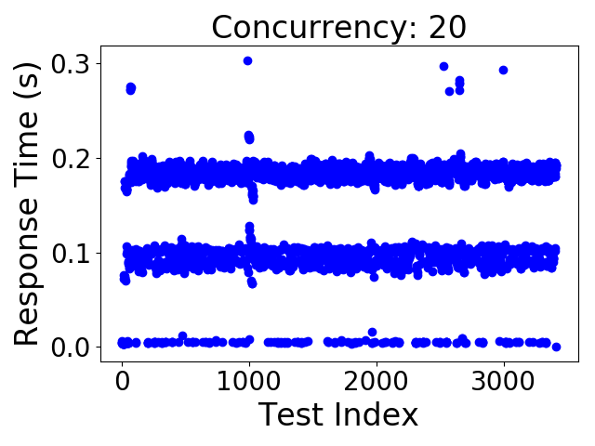
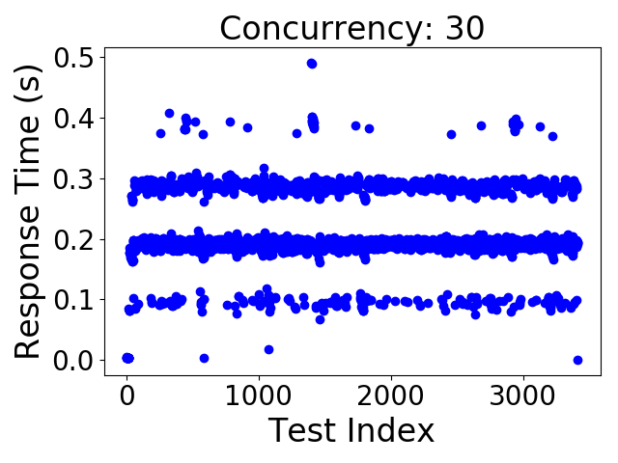
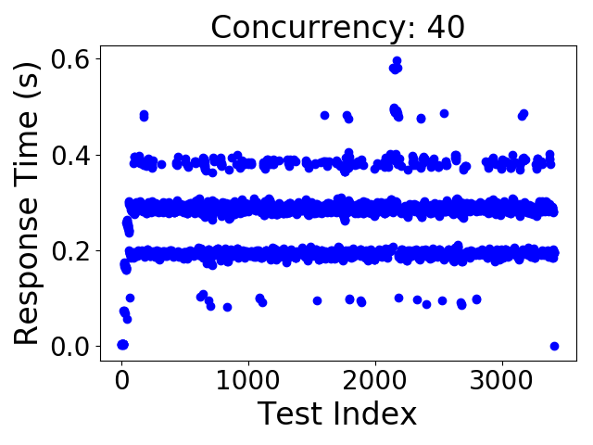
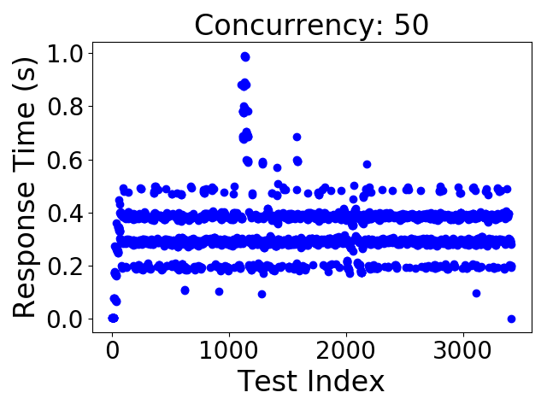
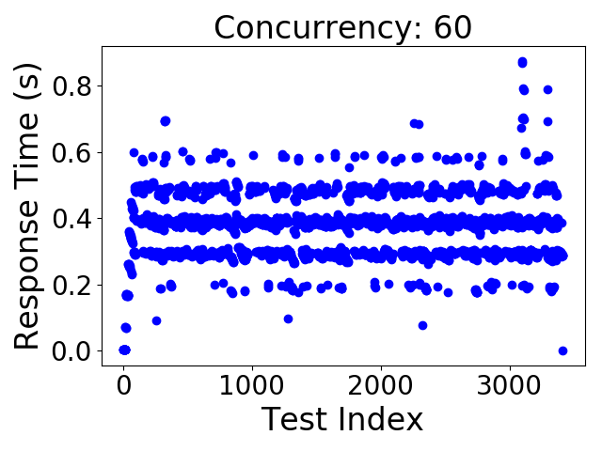
Interesting Observation 2
The number of clusters increase when the number of concurrent is increased

Slide 17
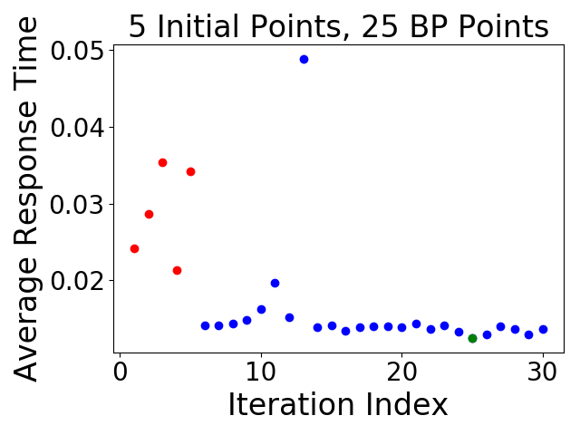
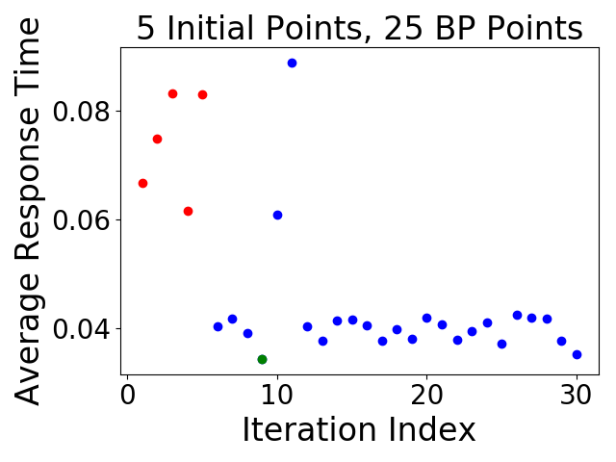
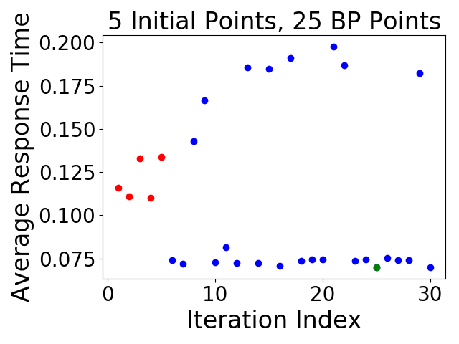
Numbers of Concurrent: 1, 5, 10
1 concurrent request
5 concurrent request
10 concurrent request
When the number of concurrent is small, it may take more iterations to make big improvement.
Starting from a number of concurrent >= 10: performance improvement is slowly increased when the iteration goes on. (Check the next two slides for the evidence.)

Slide 18
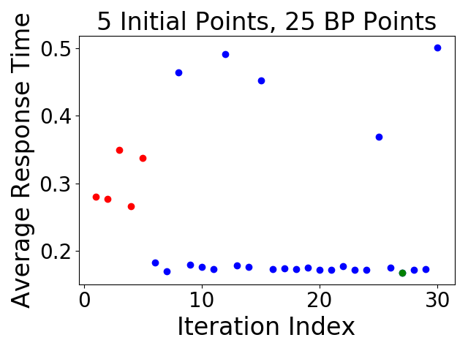
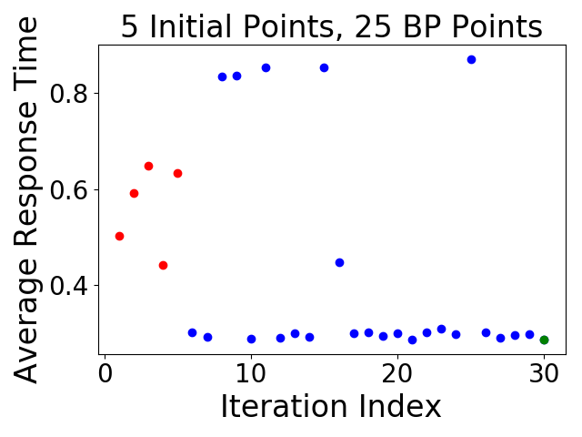
Numbers of Concurrent: 30 and 40
30 concurrent request
40 concurrent request

Slide 19
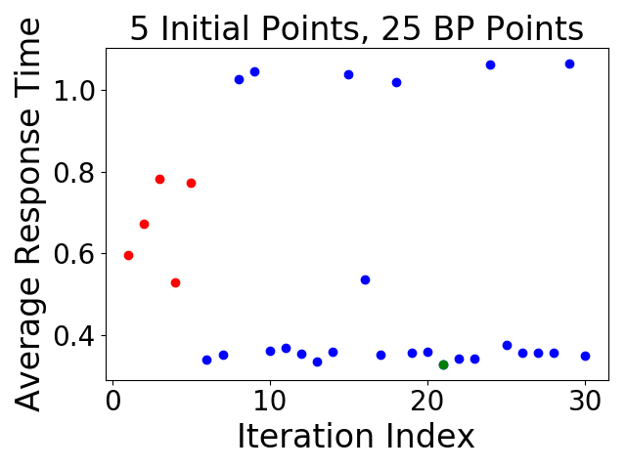
Numbers of Concurrent: 50 and 60
50 concurrent request
60 concurrent request

Slide 20
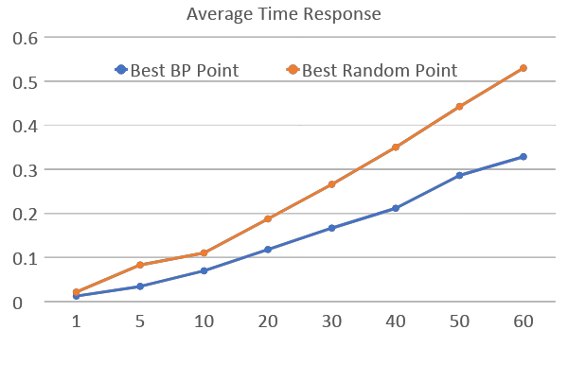
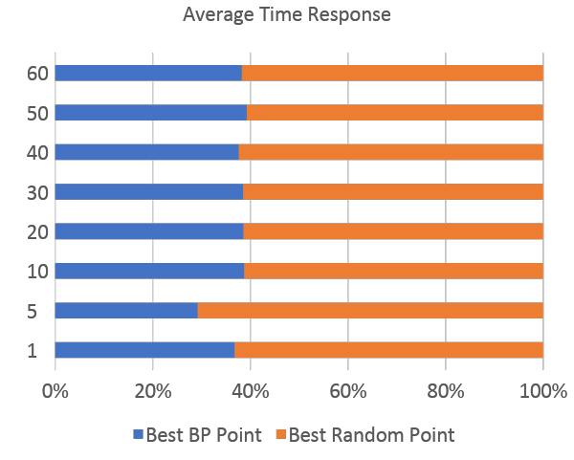
Performance Gain of Bayesian-Optimization computed point and the best random point.
Seconds
# of
concurrent
# of
concurrent

Slide 21
OPENNMT-tf
Recurrent Neural Network
Used pre-trained network on the English to German translation
Inference time might even vary depending on the length of input sequence
Used batching in nvidia-docker server
Extracted each sentence for WMT’15 data.
Used one sentence as one batch
Since inference time depends on maximum length of sentence among the batches, this might effect optimization. Moreover, it provides some randomness in the optimization process.

Slide 22
OPENNMT-tf
Configurable parameters are: Maximum Batch Size, Batch Timeout (in micros), number of replicas, max CPU, max memory and application GPU frequency
Non – configurable user-based parameters: batch size and concurrency
Output: Average Inference Time per batch per request

Slide 23
Initial Random Data Collected
Concurrency | Batch Size | Max Batch Size | Batch Timeout | Replicas | Max CPU | Max Memory (MB) | GPU Freq | Average Inference Time (s)
2 | 2 | 64 | 9080 | 16 | 0.5 | 8700 | 288 | 69.65
5 | 4 | 8 | 2658 | 4 | 0.39 | 4200 | 169 | 34.78
5 | 4 | 16 | 2622 | 4 | 0.36 | 4900 | 324 | 82.69
10 | 2 | 128 | 18837 | 7 | 0.5 | 4300 | 1306 | 75.90
10 | 2 | 8 | 46278 | 19 | 0.5 | 5700 | 771 | 112.63
10 | 4 | 32 | 2816 | 2 | 0.22 | 2700 | 1267 | 226.87
10 | 4 | 32 | 8998 | 6 | 0.5 | 5900 | 366 | 98.38
10 | 8 | 64 | 1874 | 4 | 0.5 | 8500 | 1032 | 56.65
10 | 8 | 64 | 5249 | 1 | 0.36 | 1700 | 666 | 107.38

Slide 24
OPENNMT-tf
Creating too many replicas just creates overhead – decided to limit replicas to 5
Also, limit the maximum allowed batch size to 32. Since, more batch size means more latency
It was taking took long to get the results – decided to fix the concurrency to 10 and request batch size to 4

Slide 25
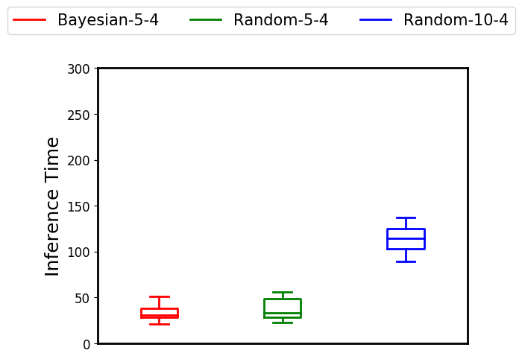

Slide 26
Best Config
Max Batch Size: 32
Batch Timeout Micros: 2778
Replicas: 1
Max CPU: 0.6
Max Memory: 4400
GPU Freq: 173
Possibly Stuck in Local Minima

Slide 27
Solution: Epsilon Greedy
Use epsilon Greedy policy
Sample randomly with probably E and use Bayesian optimized result with prob 1-E
Already used with E = 0.2
Not much difference
Need to increase E value

Slide 28
Issues
Removing the docker service
Docker-compose file
Invalid configurations

Slide 29
Conclusion
Random sampling of a configuration is good enough for a starting basis.
Taking the information gained and applying bayesian optimization can create an optimal configuration for latency in model serving.

Slide 30
Links
https://docs.docker.com/engine/reference/commandline/swarm/
https://www.tensorflow.org/serving/serving_advanced
https://medium.com/@vikati/the-rise-of-the-model-servers-9395522b6c58

